Slide 1
Advanced Simulations
Here is where your presentation begins

Slide 2
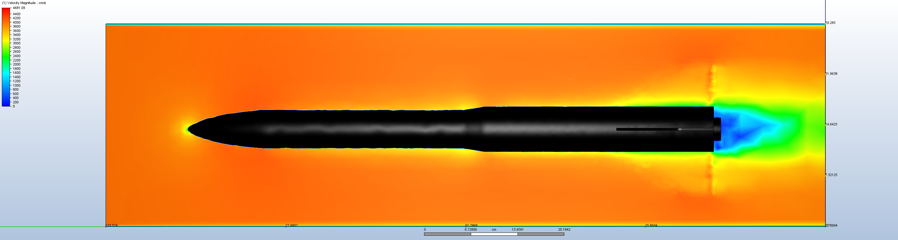
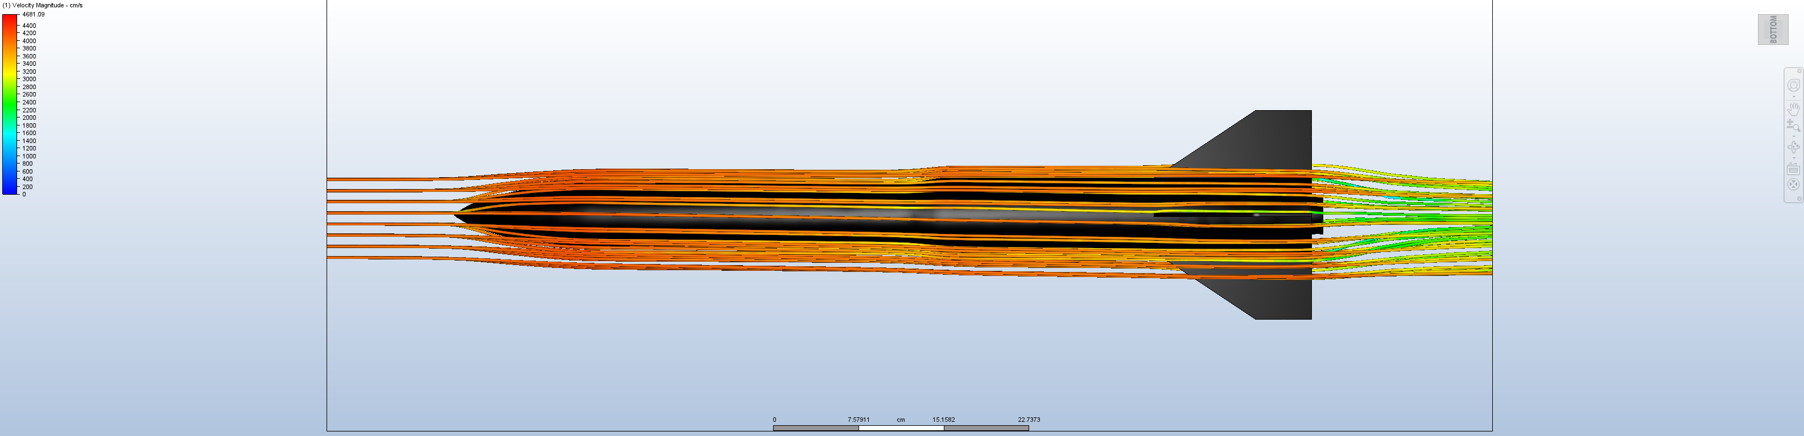
Computational Fluid Dynamics
Notes:
Guess what the colors mean – it’s the air velocity magnitude, and by extension, also air pressure

Slide 3
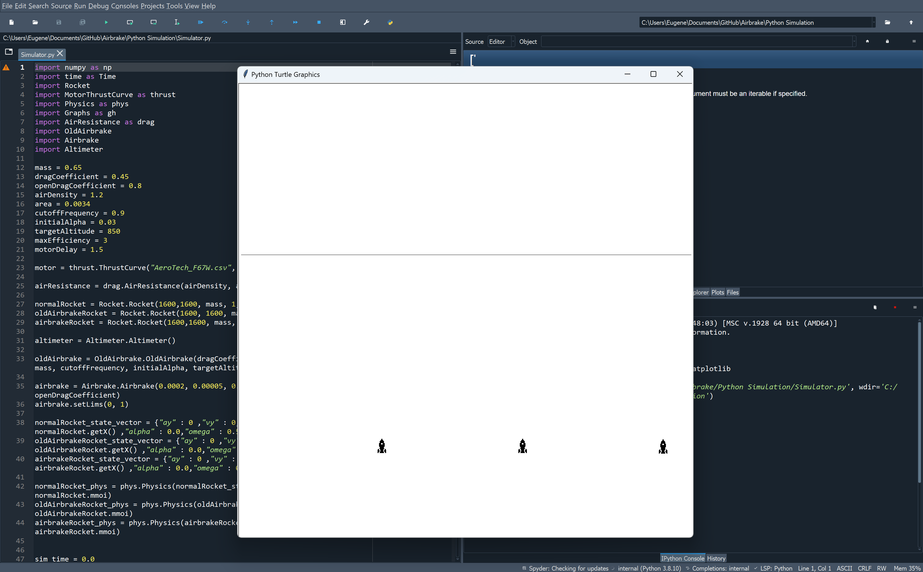
Python Simulations

